Slide 1
Marc Cahalan
Business Development Officer
September 14, 2016

Slide 2
Meeting Agenda
  Company Overview
  Needs
  Options
  Benefits
  Process

Slide 3
TCF Company Overview

Slide 4
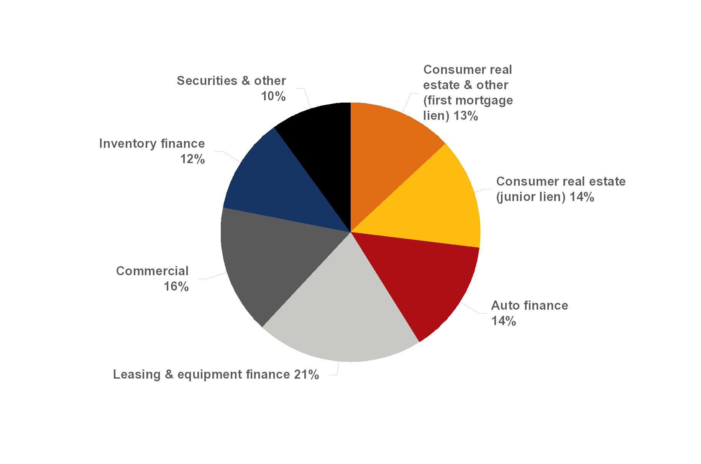
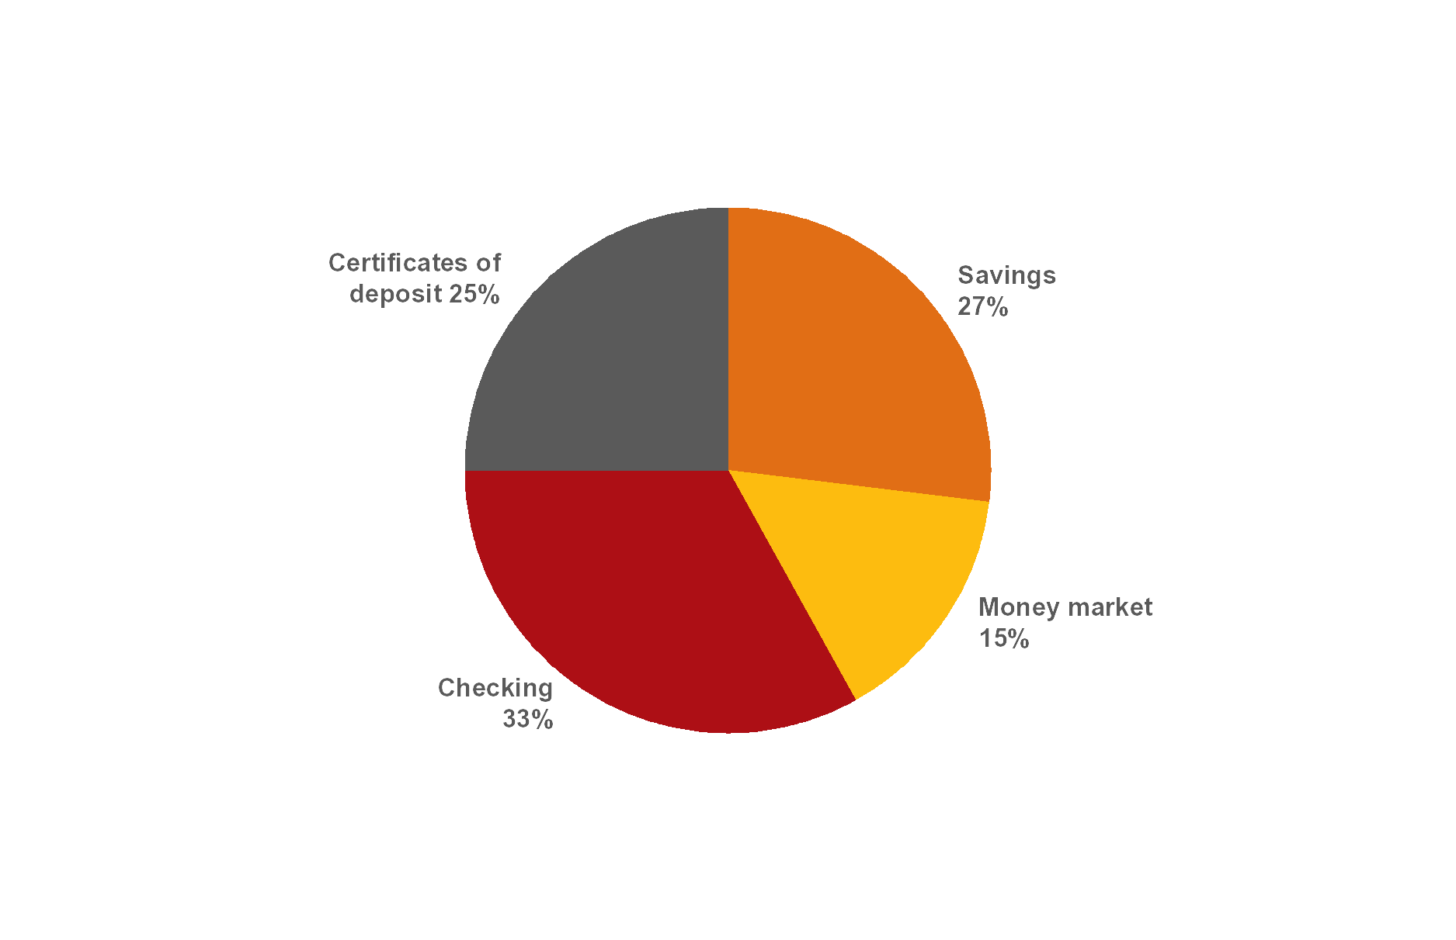
At June 30, 2016
Corporate Profile
$21.1 billion national bank holding company headquartered in Minnesota
  45th largest publicly-traded U.S. based bank holding company by asset size¹
342 bank branches in seven states
Approximately 147,700 small business banking relationships:
  69,700 checking accounts
  78,000 lending relationships
Average loan and lease portfolio makes up 84% of average total assets
A WELL-DIVERSIFIED EARNING ASSET PORTFOLIO…
($ millions)
$1,952
$2,430
$2,335
$2,678
$3,096
$2,813
$4,120
…FUNDED BY A LOW COST DEPOSIT BASE
($ millions)
$4,337
$4,677
$2,534
$5,644
4
¹ Source: SNL Financial (March 31, 2016)
² YTD annualized

Slide 5
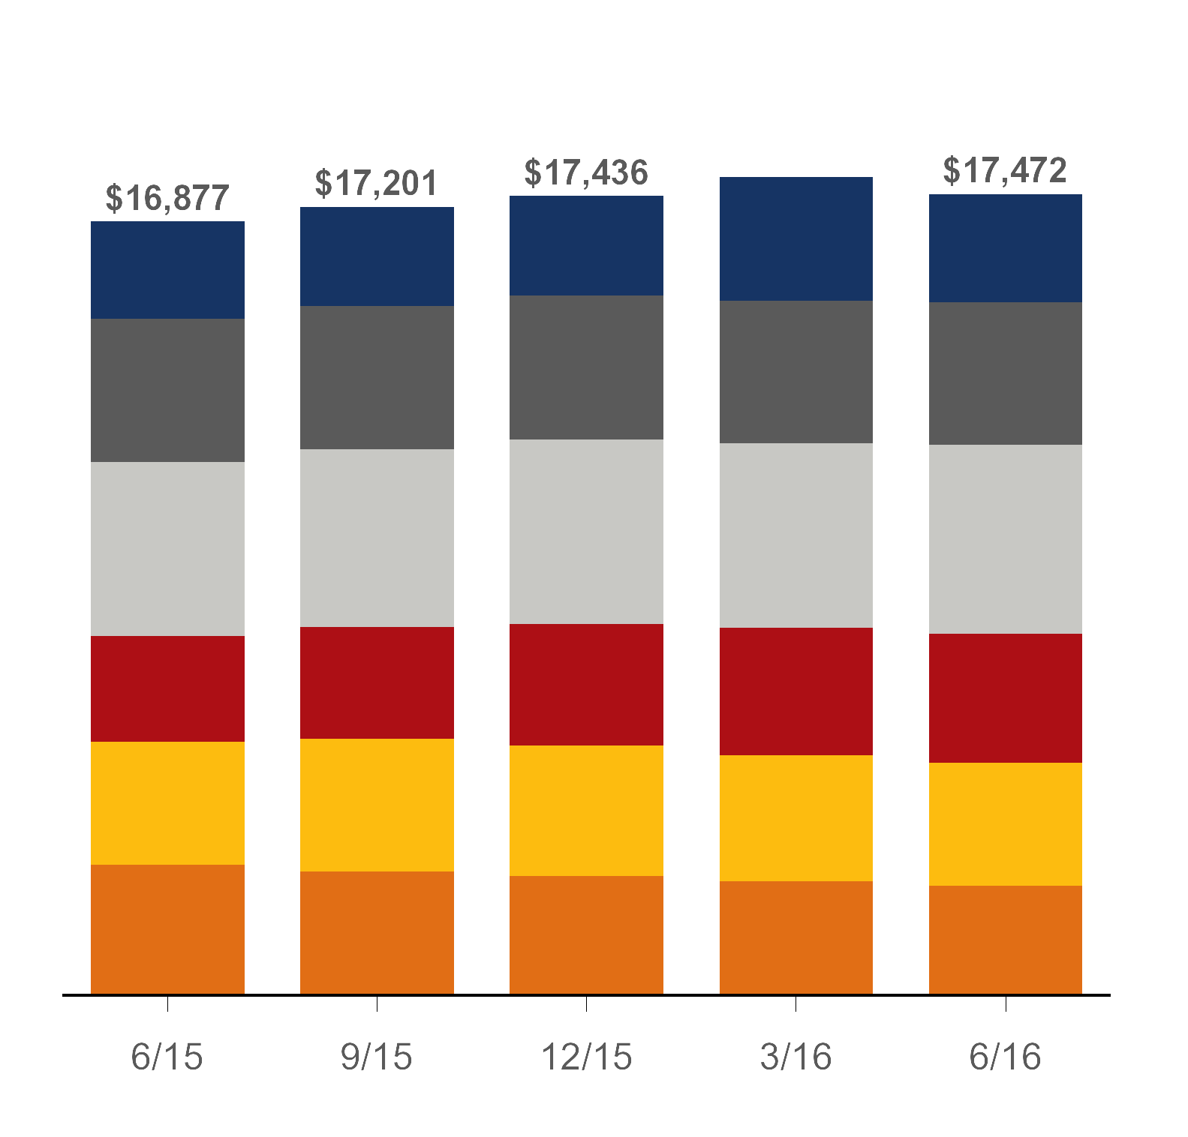

Loan and Lease Portfolio
At June 30, 2016
Inventory Finance
Commercial
Leasing & Equipment Finance
No single asset class greater than 25% of the total portfolio
Additional loan and lease diversification by geography, rate, average loan size, estimated weighted average life and collateral type
Continued run-off of consumer real estate first mortgage lien loans
Auto Finance
Consumer Real Estate - Junior Lien
Consumer Real Estate & Other - First Mortgage Lien
($ millions)
$17,853
13%
18%
22%
14%
17%
16%
13%
18%
23%
15%
16%
15%
15%
18%
22%
16%
15%
14%
13%
18%
24%
16%
15%
14%
13%
18%
22%
14%
16%
17%
55% Wholesale
45% Consumer
5

Slide 6
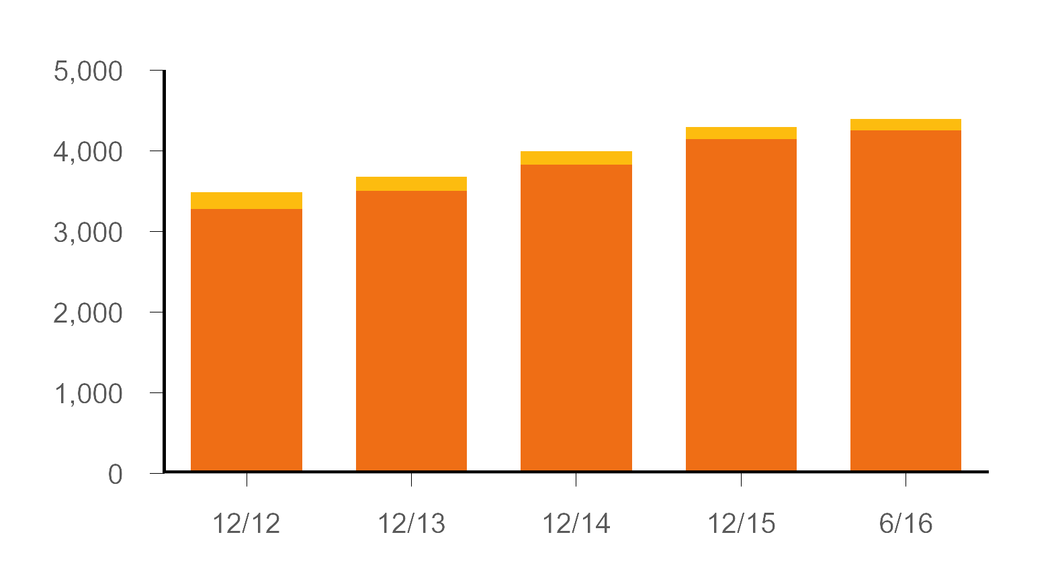
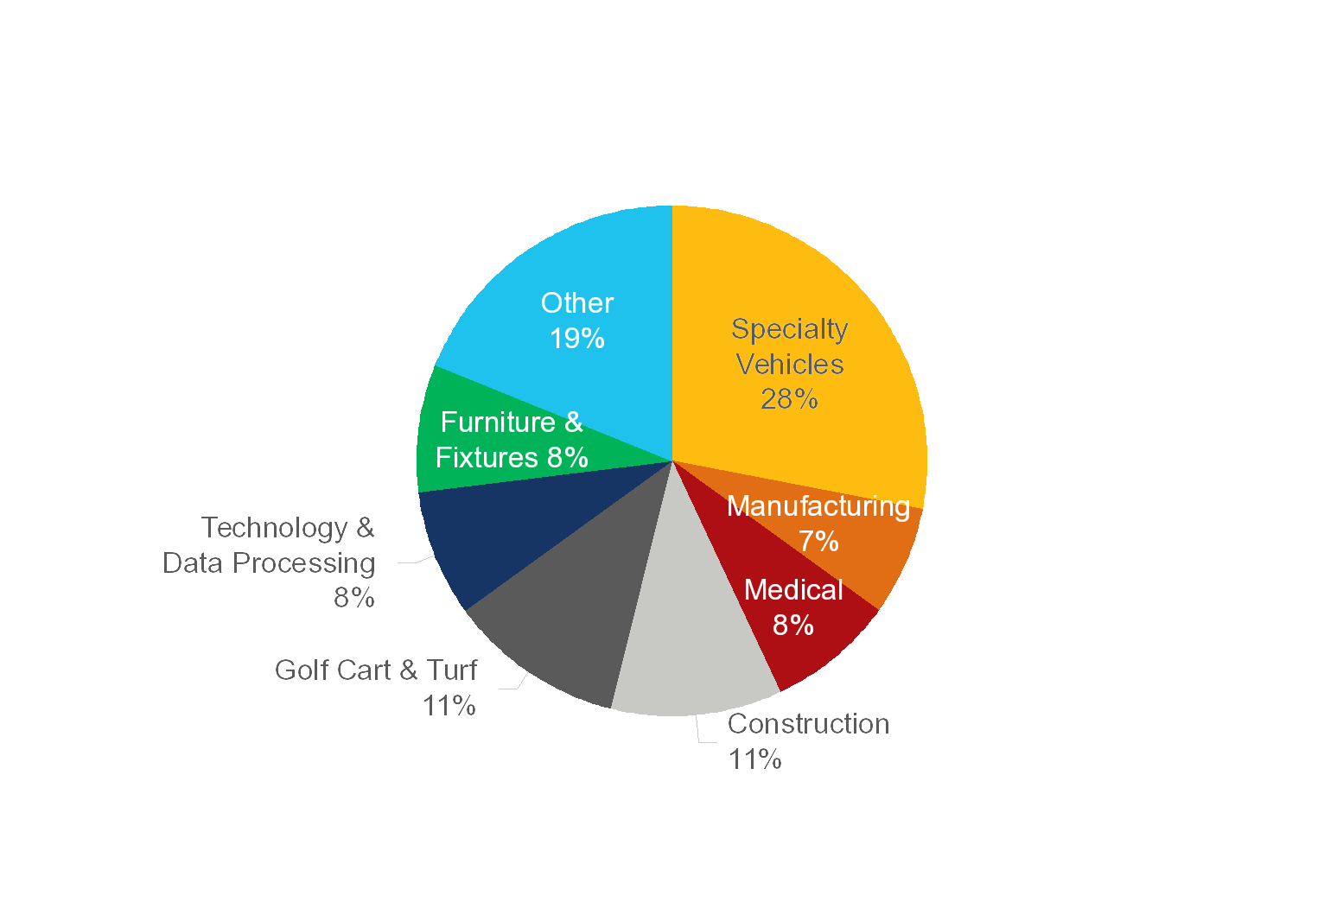
Leasing and Equipment Finance
At June 30, 2016
($ millions)
Serviced for Others
1
Portfolio Loans and Leases
$4,390
14th largest bank-affiliated leasing company² and 30th largest equipment finance/leasing company³ in the U.S.
$3,994
$4,290
$3,484
$3,679
YTD Originations | $1,696 | $1,730 | $1,874 | $1,969 | $982
Leasing & Equipment Finance
$4.1 billion
(24% of total loans and leases)
² Source: The Monitor, 2015 Monitor Bank 50
³ Source: The Monitor, 2016 Monitor 100

Slide 7
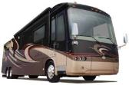


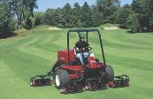




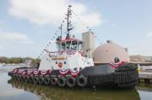
Segment Specialization
Segment | Equipment
CAPITAL MARKETS | Acquisitions Syndication buy opportunities Syndication sell opportunities
CONSTRUCTION & ENVIRONMENTAL SERVICES | Heavy highway ● Water Steel construction ● Sewer Excavation ● Demolition Refuse ● Septic trucks Redi-Mix ● Transportation
DISCOUNTING | Technology FF & E Generalist
FRANCHISE | Restaurant franchise store acquisitions Capital loans Refinances/remodels Equipment purchases Real Estate
GOLF | Golf cars Turf equipment Select irrigation equipment
HEALTHCARE / HOMECARE | General Medical ● Homecare Chiropractic ● Optical Dental ● Veterinary Fitness ● Software
MANUFACTURING | Machine tools ● Dry cleaning Wood working ● Printing & packaging Fabrication ● Food processing Commercial laundry ● Plastic injection molding
SPECIALTY MARKETS | EMS vehicles ● Shuttle & school buses Funeral vehicles ● Tire service vehicles Mechanics’ trucks ● Tow & recovery equipment Motorcoaches
STRATEGIC BUSINESS DEVELOPMENT | Agriculture Commercial Marine Municipal Strategic Expansion

Slide 8
Needs
When you are looking to acquire equipment, what
are some of the things you are considering?
  Financial situation
  Budget
  Maintenance practices
  Technological advances

Slide 9

Options
Paying Cash
Bank Loan
3rd Party Lease Financing

Slide 10

Which one is best…
Our goal is to help you assess the many factors which can affect your decision to purchase or lease. We provide the information to help you tailor the best, most viable long-term plan for acquiring and managing your assets.

Slide 11
Paying Cash
Using your cash for new equipment purchases may not be the most viable option
  Very few have enough cash to buy everything that is needed
  Use cash for things you cannot finance
  Cash payment has an immediate impact on cash flow by diminishing cash reserves
  Paying cash for soft costs, such as installation and delivery erodes available cash

Slide 12
Bank Loan
Bank Line of Credit
  Although it preserves capital, a loan may impact your available credit and dip into your cash reserve
  Conserve your line for day to day business operations, as needed
  Important to note
  Most banks do not offer 100% financing (such as soft costs and maintenance agreements)

Slide 13
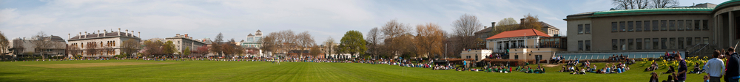
Lease Financing
Flexible structuring options
  Seasonal or delayed payment programs,
  Manufacturer Promotions
  Transactions structured to match payments to your cash flow
Competitive rates
If budgets are tight, you can still acquire needed equipment now
Lease financing may be the best alternative because of the flexible options

Slide 14
Different types of leases
Fair Market Value
Also known as an Operating Lease or Tax Lease
Lessor (TCFEF) is owner of the equipment throughout the term
Payments may qualify for a tax deduction
Multiple End of Lease Term Options
  Purchase Equipment
  Renew Lease
  Return Equipment
$1.00 Purchase Option
Also known as a Capital Lease
Lessee is owner of the equipment throughout and at the end of the term
Lessee take the depreciation
Typically used to purchase longer term equipment
Lessee owns equipment at End of Term for $1.00
Municipal Leasing

Slide 15
How much Equipment can a yearly budget buy?
$50,000.00 per year budget
  50,000 / 12 months = $4,166.67/mo payment
    60 month CSC = $221,715 of equipment at 5% finance rate.
    48 month 600 hour FMV = $231,800 of equipment
    48 month 900 hour FMV = $220,200 of equipment
    60 month 600 hour FMV = $254,800 of equipment
    60 month 900 hour FMV = $243,800 of equipment
$100,000.00 per year budget
  100,000 / 12 months = $8,333.33/mo payment
    60 month CSC = $443,430 of equipment at 5% finance rate.
    48 month 600 hour FMV = $463,600 of equipment
    48 month 900 hour FMV = $440,400 of equipment
    60 month 600 hour FMV = $509,750 of equipment
    60 month 900 hour FMV = $487,600 of equipment

Slide 16
Benefits of Leasing
Flexible Options: Level, Seasonal, Annual, Skip Payments, Fair Market Value, $1.00 Purchase Option. Tailor the best structure that is beneficial to your club. **We get creative when necessary!
100% Financing: Acquire needed equipment without a major initial cash outlay
Protect against obsolescence: Keep equipment up to date
Lower repair costs: Match term with useful life
Preserve Bank Credit Lines: Leave credit for when you need it.
Overcome budget limitations: Lower monthly payments
Hedge against inflation: lock in today’s rates/pricing and pay with tomorrow’s dollars

Slide 17
Easy Process to Lease
1 page credit application
  Application only program up to $350,000
Financial Statements
  Only needed in only certain scenarios
  Needed if application is over $350,000
Credit approved!
Documents are produced/emailed to customer
Signed, faxed/emailed and returned
Delivery and Installation complete
Sign Delivery & Acceptance certificate – faxes or emails

Slide 18

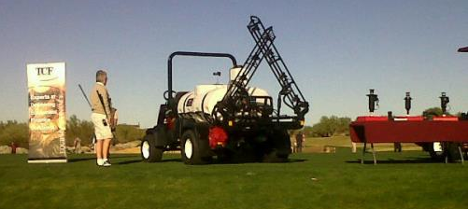
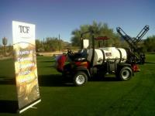
Open Discussion
Questions?
Comments.

